Slide 1
Development of master curricula for natural disasters risk management in Western Balkan countries
EU examples of student internships organisation – BOKU
Priv.-Doz. DI Dr. Michael Tritthart
University of Natural Resources and Life Sciences BOKU, Vienna
Project Management Committee meeting/ 06th September 2018
Project number: 573806-EPP-1-2016-1-RS-EPPKA2-CBHE-JP
"This project has been funded with support from the European Commission. This publication reflects the views only of the author, and the Commission cannot be held responsible for any use which may be made of the information contained therein"

Slide 2
Content
Development of master curricula for natural disasters risk management in Western Balkan countries
Overview of internships at BOKU
Internship organisation of bachelor programme „Civil Engineering and Water Management“
International internship organisation - IAESTE

Slide 3
Overview of internships
Development of master curricula for natural disasters risk management in Western Balkan countries
PROGRAMME | MANDATORY/ ELECTIVE | DURATION
Bachelor programme Food Science and Biotechnology | mandatory | 4 weeks
Bachelor programme Landscape Architecture and Landscape Planning | elective | 4 weeks
Bachelor programme Forestry | mandatory | 4 weeks
Bachelor programme Wood and Fibre Technology | mandatory | 4 weeks
Bachelor programme Environment and Bio-Resources Management | mandatory | 4 weeks
Bachelor programme Civil Engineering and Water Managment | mandatory | 5 weeks
Bachelor programme Agricultural Sciences | mandatory | 8 weeks
Bachelor programme Equine Sciences | mandatory | 17 weeks
Master programme Wildlife Ecology and Wildlife Management | mandatory | 4 weeks
Master programme Food Science and Technology | mandatory | 4 weeks
Master programme Landscape Architecture and Landscape Planning | none
Master programme Phytomedicine | elective | 4 weeks
Master programme Forest Sciences | none
Master programme Wood Technology and Management | mandatory | 3 weeks
Master programme Environment and Bio-Resources Management | none
Master programme Civil Engineering and Water Management | none
Master programme Plant Sciences | elective | 4 weeks
Master programme Livestock Sciences | none
Master programme Agricultural and Food Economy | none
Master programme Material and Energetic Exploitation of Renewable Raw Materials (NAWARO) | none
Master programme Alpine Natural Dangers/ Watersched Regulation | none
Master programme Viticulture, Enology and Wine Economics | none
Master programme Organic Agricultural Systems and Agroecology (AgrEco-Organic) und Organic Agricultural Systems and Agroecology (EUR-Organic) | elective | 4 weeks

Slide 4
Internship organisation of BSc „Civil Engineering and Water Management“
Development of master curricula for natural disasters risk management in Western Balkan countries
Mandatory internship of 5 weeks
Students are searching for an internship – ON THEIR OWN! → Support by Austrian Student Union -) Writing a CV -) International internships -) Rights and obligations -) Map of possible employers -) etc.
Upon presentation of several rejections → Assistance in scientific projects at University

Slide 5
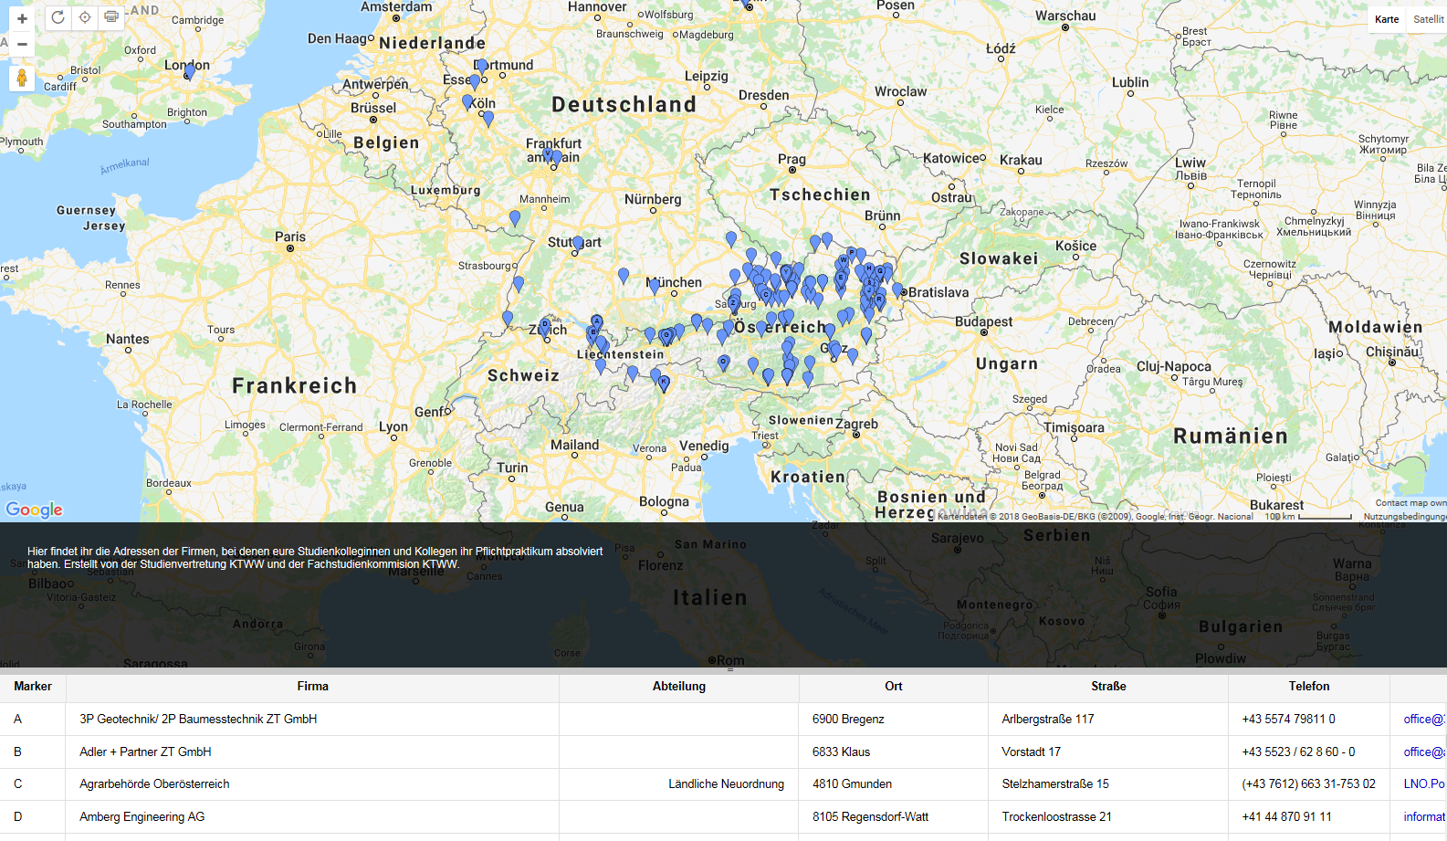
Internship organisation of BA „Civil Engineering and Water Management“
Development of master curricula for natural disasters risk management in Western Balkan countries
Map of possible employers

Slide 6
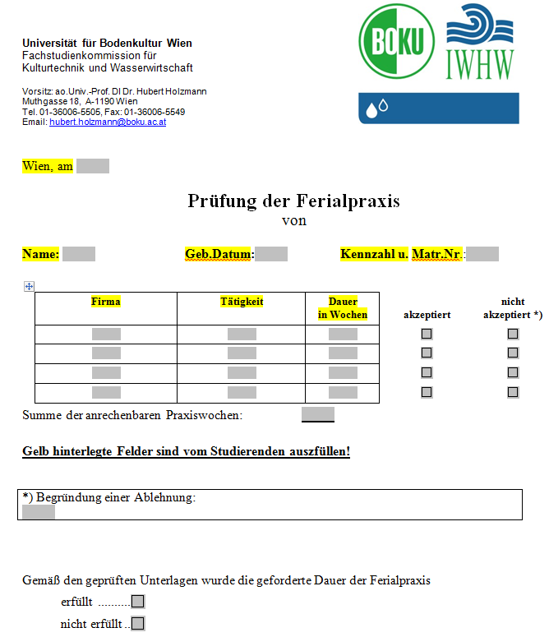
Internship organisation of BA „Civil Engineering and Water Management“
Development of master curricula for natural disasters risk management in Western Balkan countries
Procedure of the internship
Preliminary preparation -) Registration in the course “internship” in the online-system of the University -) Verification of the employer’s suitability by the study programme commission
Completion of the internship
Postprocessing -) Completing the form “praxis_ktww.doc” -) Certification of the employer -) Writing of an internship report (information about tasks, methods, results, etc.)

Slide 7
International internship organisation - IAESTE
Development of master curricula for natural disasters risk management in Western Balkan countries
International Association for the Exchange of Students for Technical Experience
Non-profit organisation operated by students for students
Providing study-field specific internships in the technical and natural sciences
Operating network in more than 80 countries
Organising internships for Austrian students abroad
Providing internships for international students in Austria
https://iaeste.org/

